Slide 1
Stretched link
Taught by Yossef Ayman Zedan

Slide 2
Overview
Add .stretched-link to a link to make its containing block clickable via a ::after pseudo element. In most cases, this means that an element with position: relative; that contains a link with the .stretched-link class is clickable. Please note given CSS position works, .stretched-link cannot be mixed with most table elements.
Cards have position: relative by default in Bootstrap, so in this case you can safely add the .stretched-link class to a link in the card without any other HTML changes.
Multiple links and tap targets are not recommended with stretched links. However, some position and z-index styles can help should this be required.

Slide 3
Examples
<div class="card" style="width: 18rem;"> <img src="..." class="card-img-top" alt="..."> <div class="card-body"> <h5 class="card-title">Card with stretched link</h5> <p class="card-text">Some quick example text to build on the card title and make up the bulk of the card's content.</p> <a href="#" class="btn btn-primary stretched-link">Go somewhere</a> </div> </div>

Slide 4
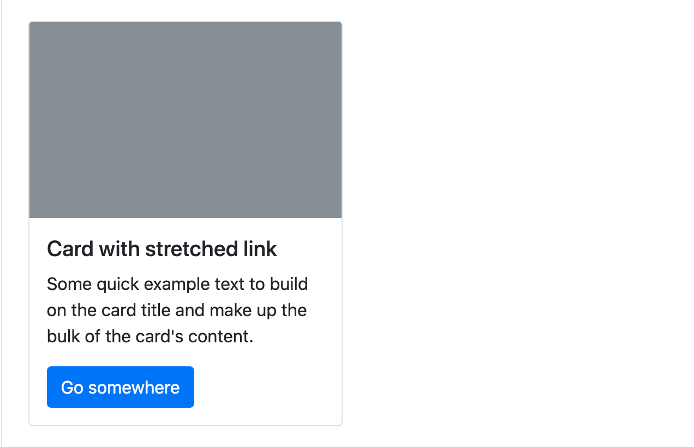
Examples

Slide 5
Examples
Most custom components do not have position: relative by default, so we need to add the .position-relative here to prevent the link from stretching outside the parent element.
<div class="d-flex position-relative"> <img src="..." class="flex-shrink-0 me-3" alt="..."> <div> <h5 class="mt-0">Custom component with stretched link</h5> <p>This is some placeholder content for the custom component. It is intended to mimic what some real-world content would look like, and we're using it here to give the component a bit of body and size.</p> <a href="#" class="stretched-link">Go somewhere</a> </div> </div>

Slide 6
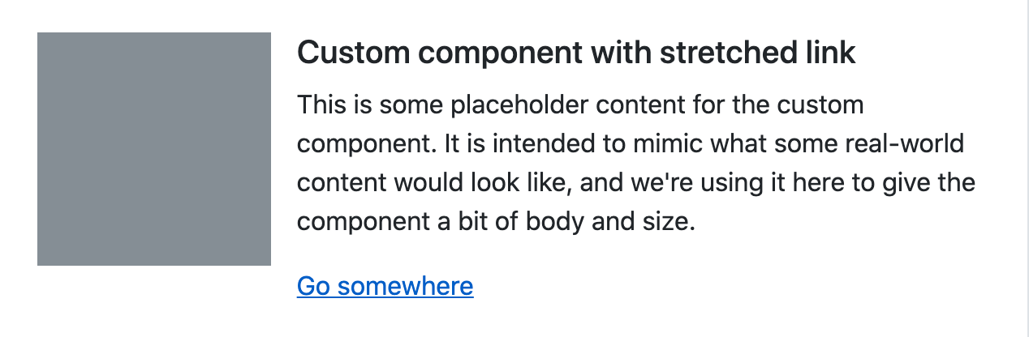
Examples

Slide 7
Examples
<div class="row g-0 bg-light position-relative"> <div class="col-md-6 mb-md-0 p-md-4"> <img src="..." class="w-100" alt="..."> </div> <div class="col-md-6 p-4 ps-md-0"> <h5 class="mt-0">Columns with stretched link</h5> <p>Another instance of placeholder content for this other custom component. It is intended to mimic what some real-world content would look like, and we're using it here to give the component a bit of body and size.</p> <a href="#" class="stretched-link">Go somewhere</a> </div> </div>

Slide 8
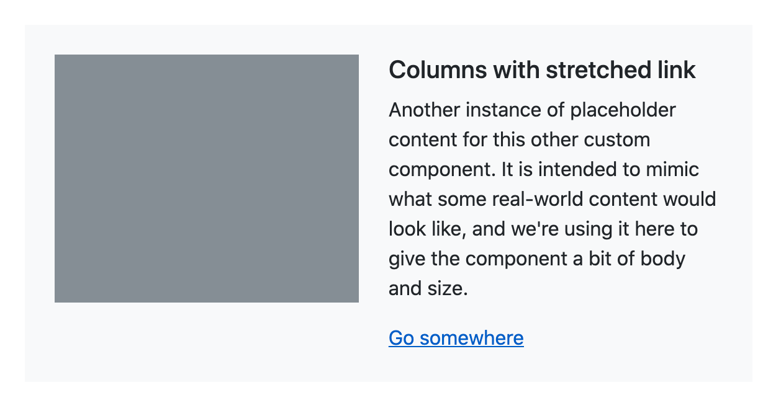
Examples

